Slide 1
Network Layer Protocols: ARP and RARP

Slide 2

Figure Position of ARP and RARP in TCP/IP suite

Slide 3
ARP
and
RARP

Slide 4
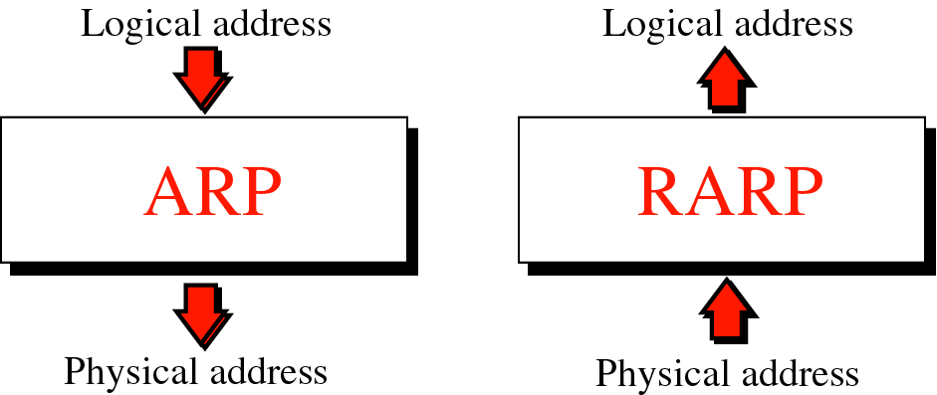

Slide 5
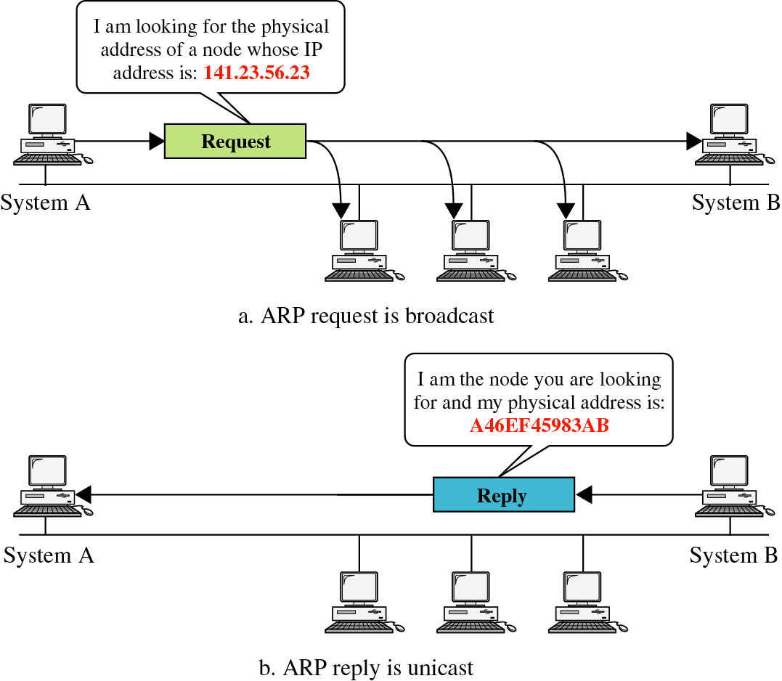

Slide 6
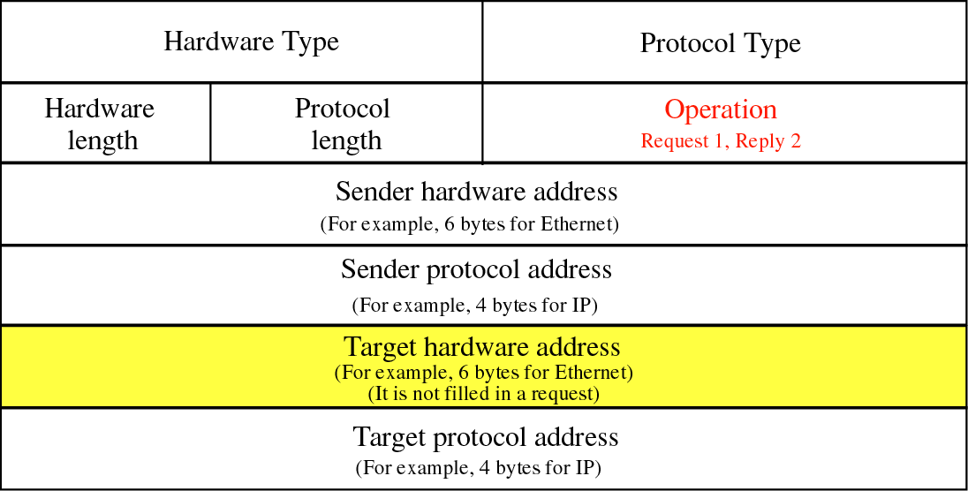

Slide 7


Slide 8
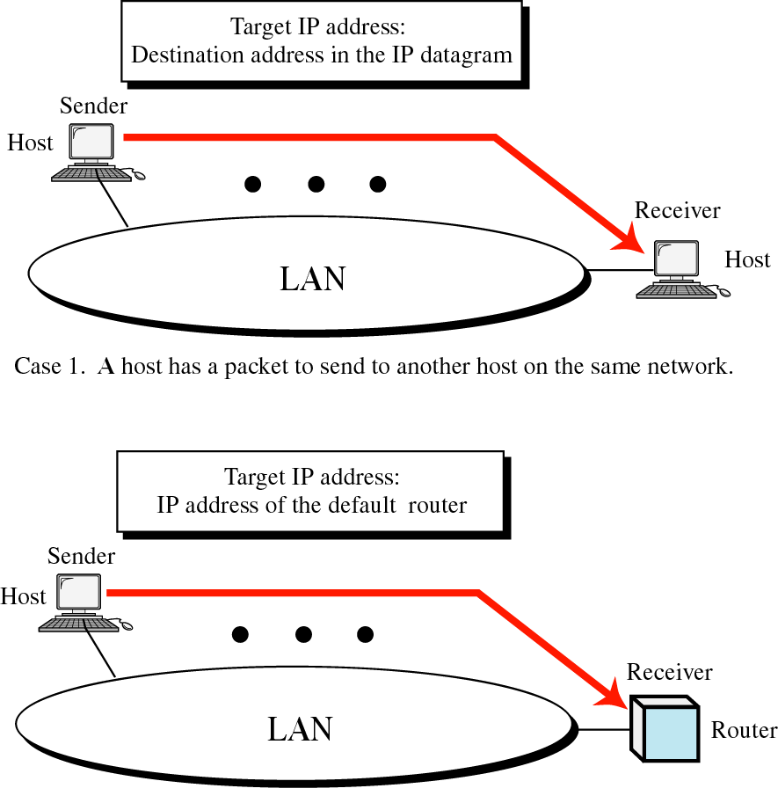

Slide 9
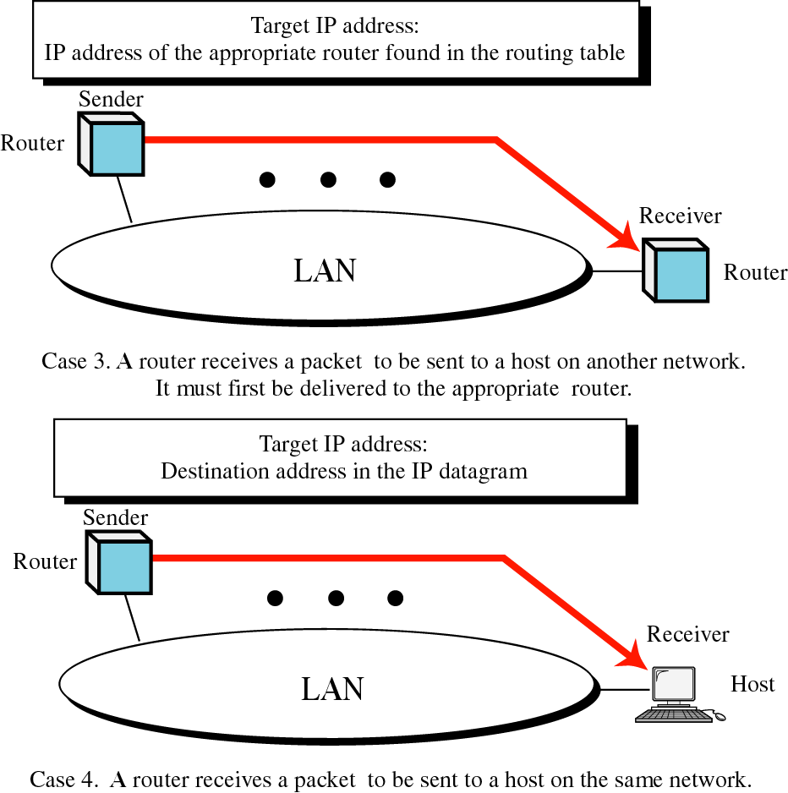

Slide 10
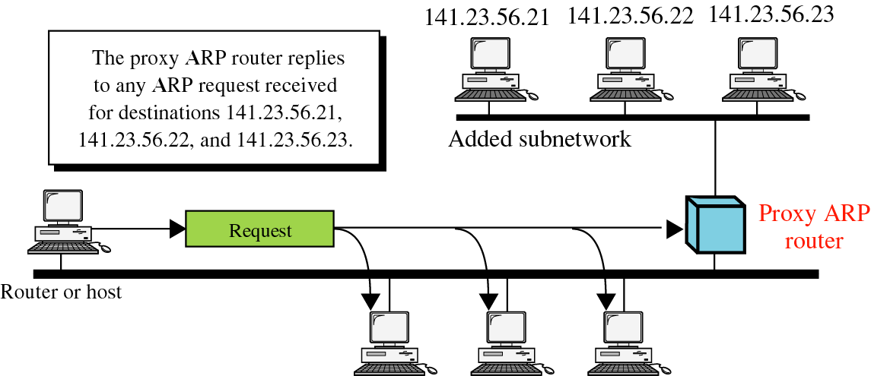

Slide 11
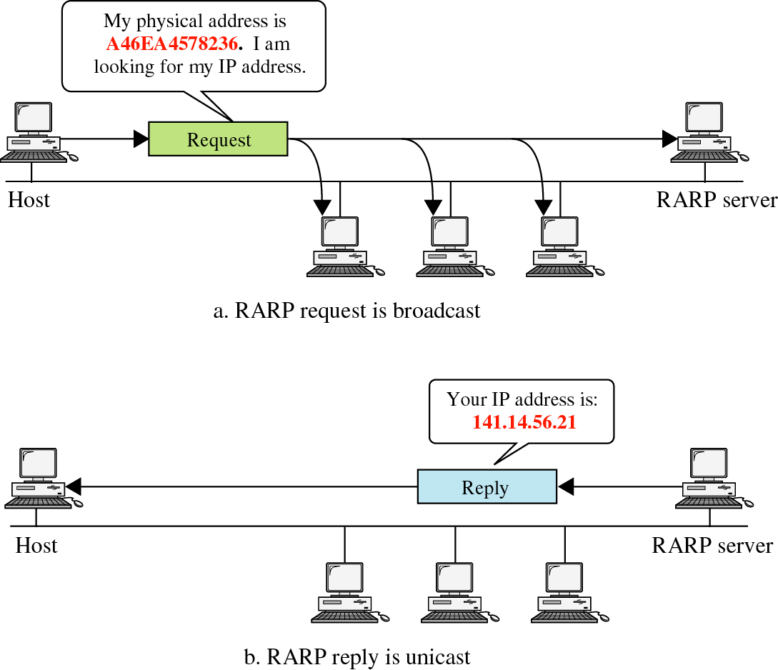

Slide 12
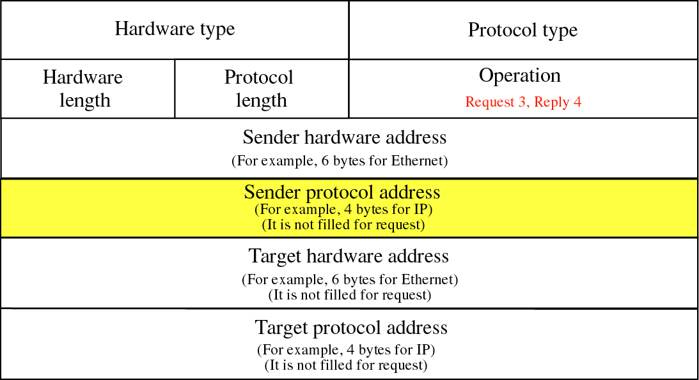

Slide 13


